Slide 1


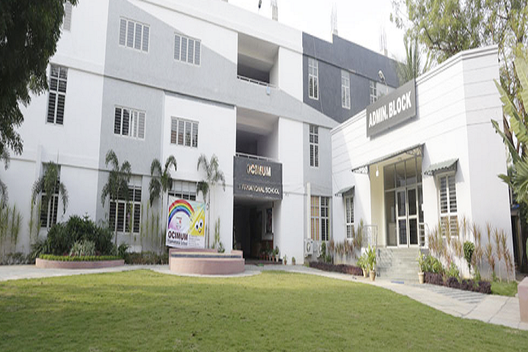
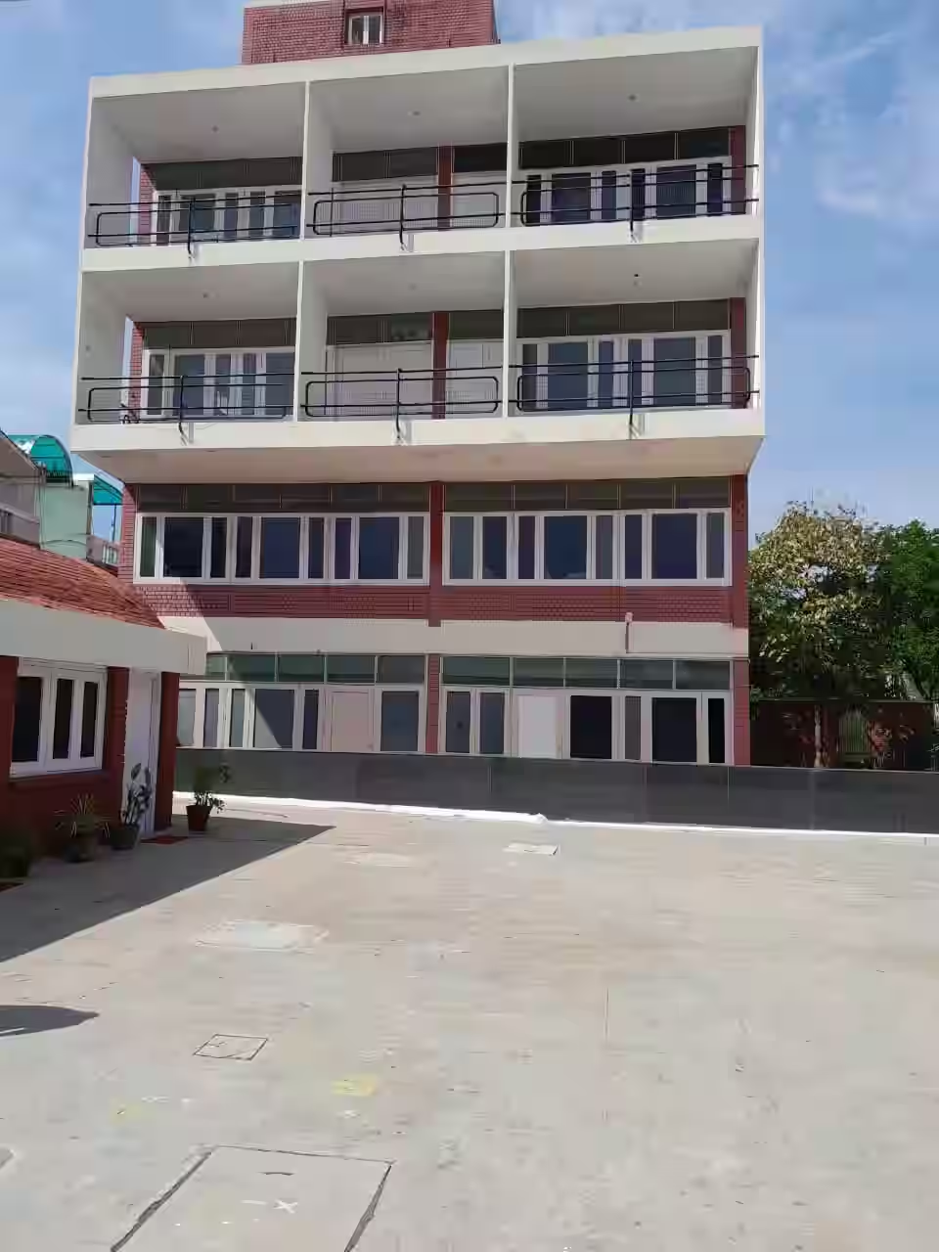
WELCOME TO ACADEMIC ORIENTATION 2023-24
“An ISO 9001 Certified Institution"
BOWENPALLY
MAHINDRA HILLS

Slide 2



Ocimum International School is “ An ISO 9001 Certified Institution”. The ISO 9001 standard for education sector ensures to fulfil learner’s expectations and encourage continuous development to meet the rapidly changing demands of the learner in the educational sector. The School is affiliated to CBSE board. Ocimum International School was established in June 2013 with a single moto to provide quality education.

Slide 3
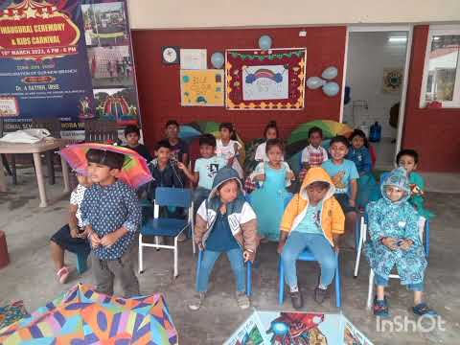

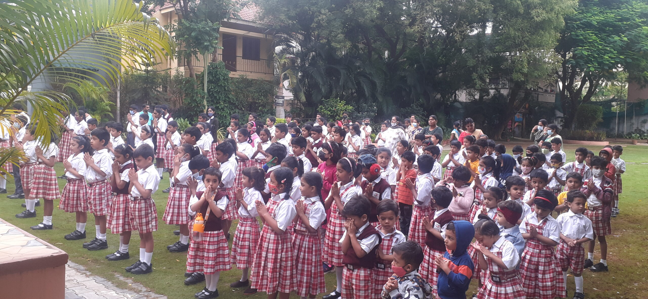
OUR VISION
Ocimum international school will ensure that students add value to their community and make the world a better place to live.
The school will deliver learning excellence that is child centric, value-based and technology driven.
Education with a difference
NO CHILD LEFT BEHIND

Slide 4
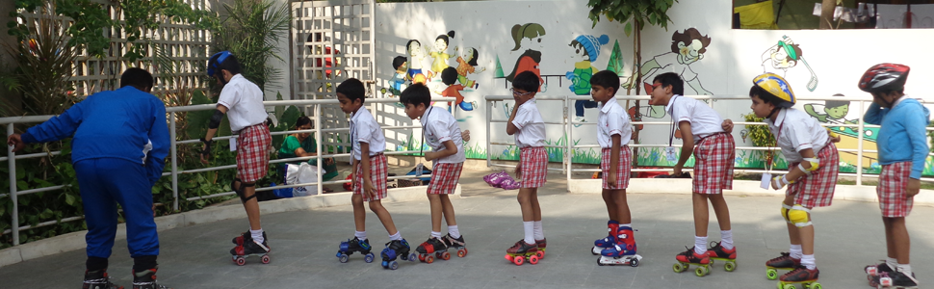
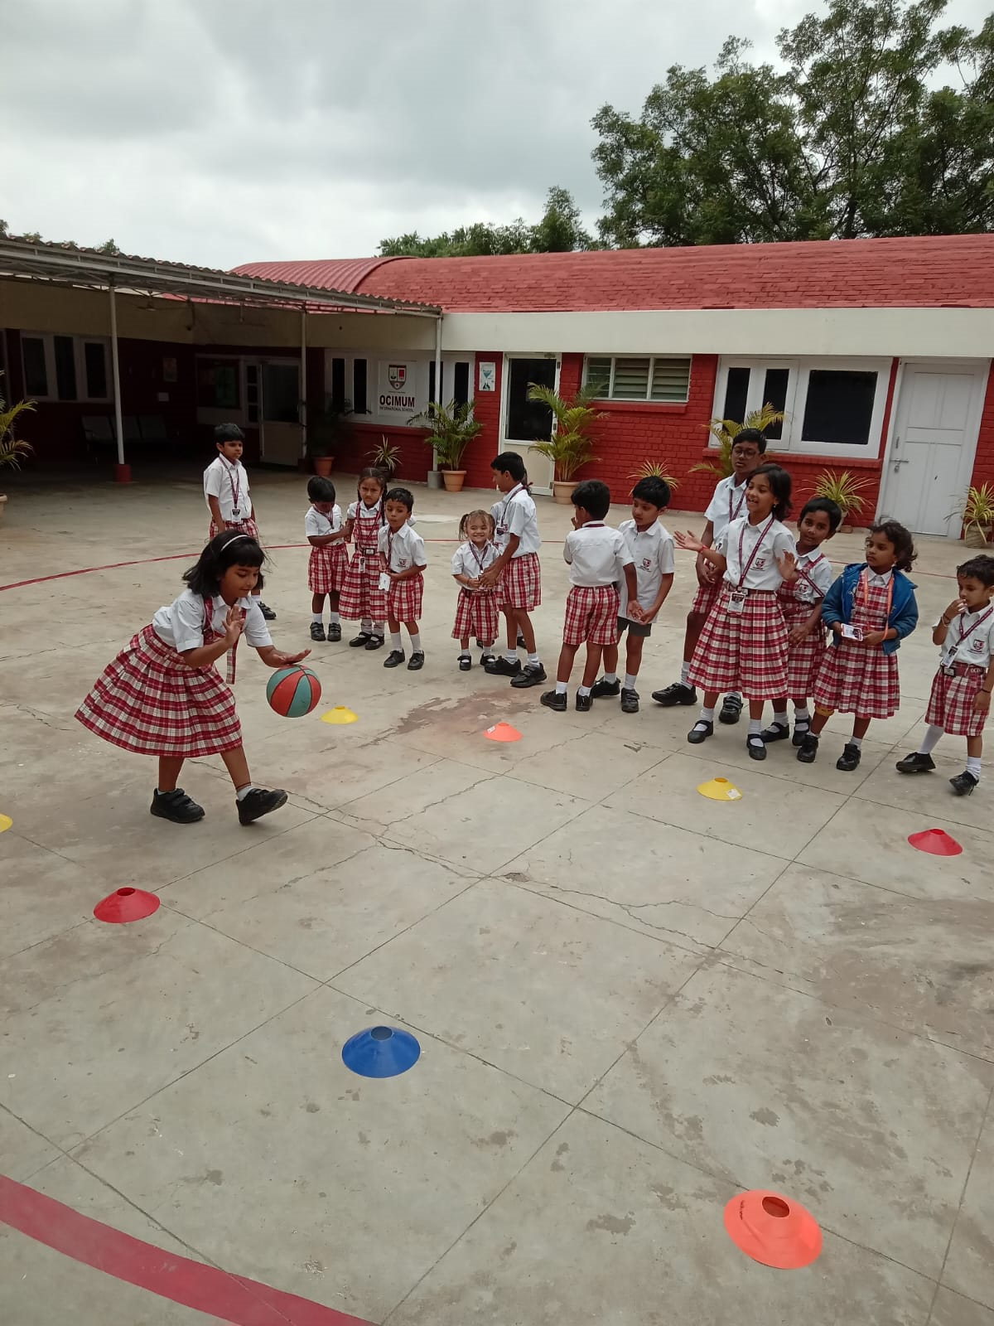


OUR INFRASTRUCTURE
Aesthetically Designed Classrooms
Age-appropriate Furniture
Well stocked Library
Audio Visual Room
Hygienically maintained Swimming Pool
Indoor and Outdoor Games Facility
24×7 CCTV surveillance
Safe and Secured School Campus
Transport facility
Well trained teachers

Slide 5

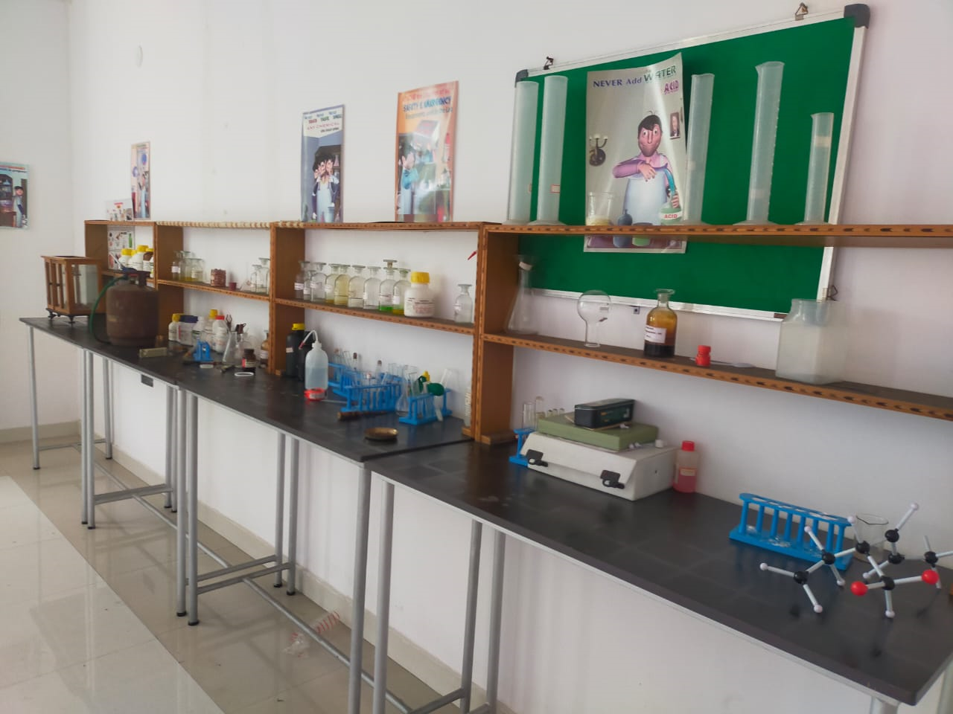
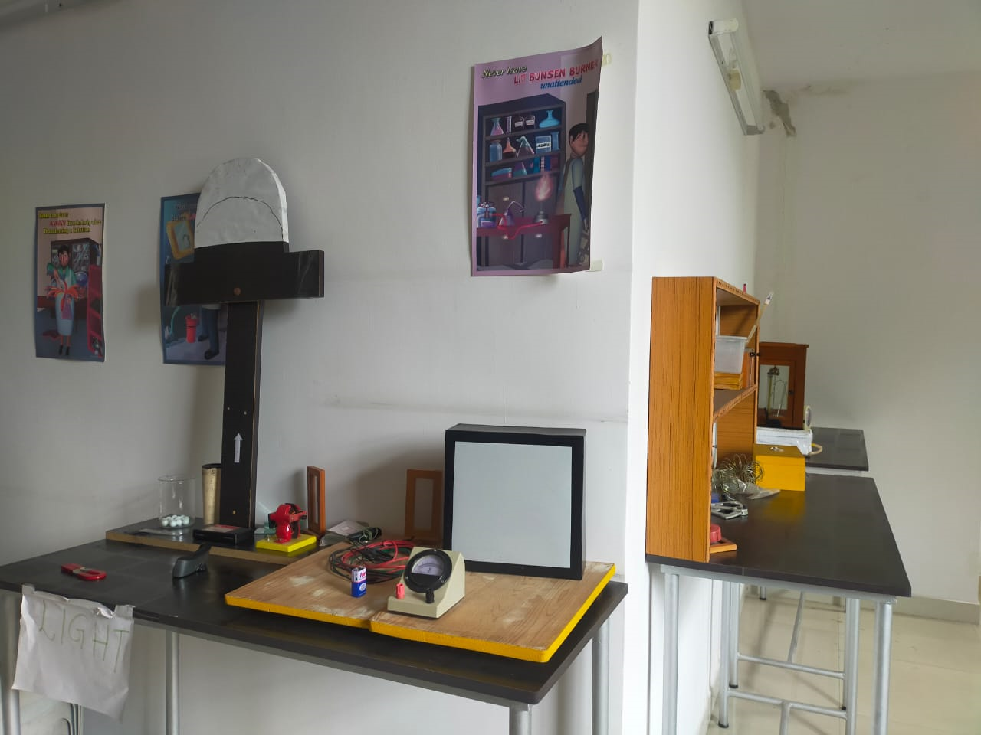
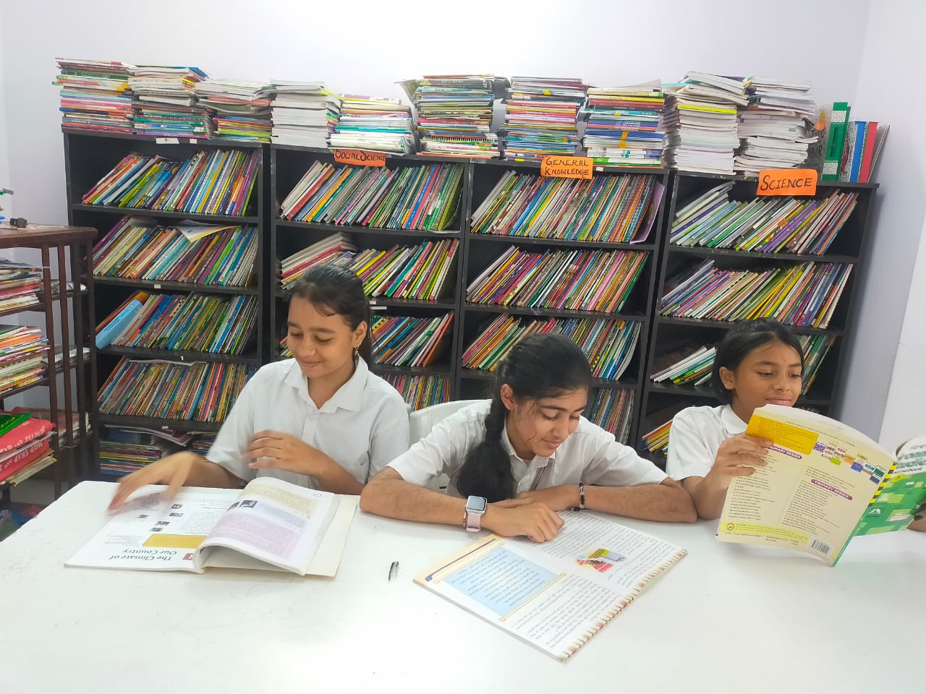
Library
Computer labs
Science labs
Robotics lab
Performing art facilities like Art, Dance, Dramatics, Music.
Medical room
The Science labs ( Physics, Chemistry and Biology) gives students Hands-on -experience , encourages creativity , develops critical thinking and self- directed learning.
The School library provides a wide range of materials and activities to help children learn and develop reading skills . They can foster creativity and help build their social skills in a stress free environment.
Apart from books, our school library offers various national and international journals, academic and current affairs magazines and newspapers. Thus, they keep children well informed about what is happening worldwide.

Slide 6



CHAIN OF COMMUNICATION
Step 1: Mother teacher
Step 2: Coordinator
Step 3: Head Mistress
Step 4: Principal

Slide 7

PRE PRIMARY CURRICULUM OVERVIEW
The curriculum offers developmentally appropriate program with cumulative assessment options.
Seven key learning areas:
Communication and language skills
Reading and writing
Physical development
Personal, social and emotional development
Mathematics
Understanding the world around us
Art and craft

Slide 8



ASSESMENT OF STUDENTS LEARNING
Assessment of the Student is based on daily/weekly/monthly observations and continuous class assessment. There are two academic terms. Each term has one periodic test and one term end examination. Progress Reports are prepared based on these periodic test and term end examinations.
GRADED ACTIVITIES
Spell Bee- help students improve their spelling, increase their vocabularies, learn concepts and develop correct English usage that will help them all their lives.
Cursive writing and handwriting
Drawing and coloring
Speaking and listening skills

Slide 9
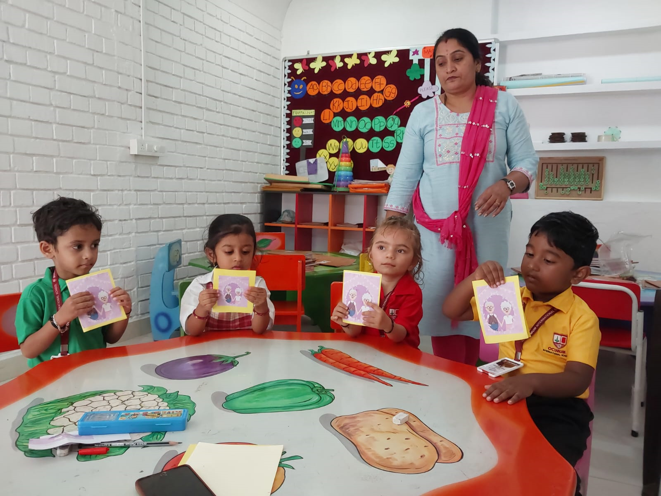
NURSERY
WHAT DO WE TEACH?
HOW DO WE TEACH?
Multiple intelligence based curriculum
Reading
Writing
Listening
Speaking
General knowledge
Number sense and shape
Behavioral habits
Body movements
Puzzle solving
Rhymes
Stories and conversations
Art based activities
Story based approach

Slide 10
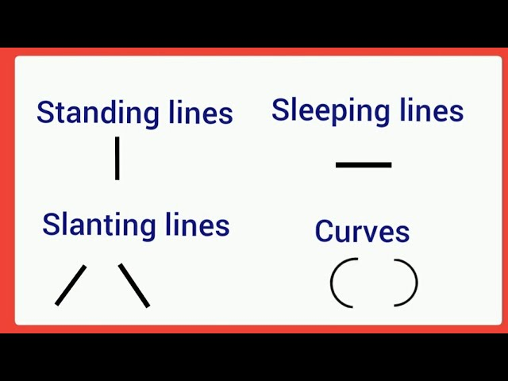


PP1 OVERVIEW OF CONCEPTS TAUGHT IN ENGLISH
Alphabet Song- Orals
Standing Line, Sleeping Line, Slanting Lines
Curve, Inverted C- curve
Alphabets
Vocabulary
Role – play ( Communication and Language skills are vital for learning)
Narrate a self created story ( develops their comprehensive skills, critical thinking , listening skills also encourages to communicate their thoughts, feelings and ideas).

Slide 11
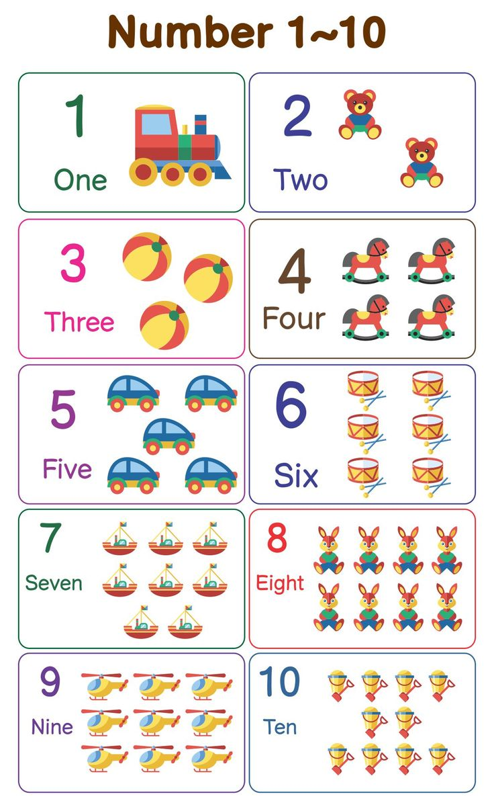

PP1 OVERVIEW OF CONCEPTS TAUGHT IN MATH
Numbers 1-50- Orals
Number names 1 to 10
Backward counting 10-1
Shapes- Square, Rectangle, Triangle and Circle
Patterns- Standing, Sleeping, Slanting
Tall/Short, Big/Small
Missing, before, after, in between numbers

Slide 12
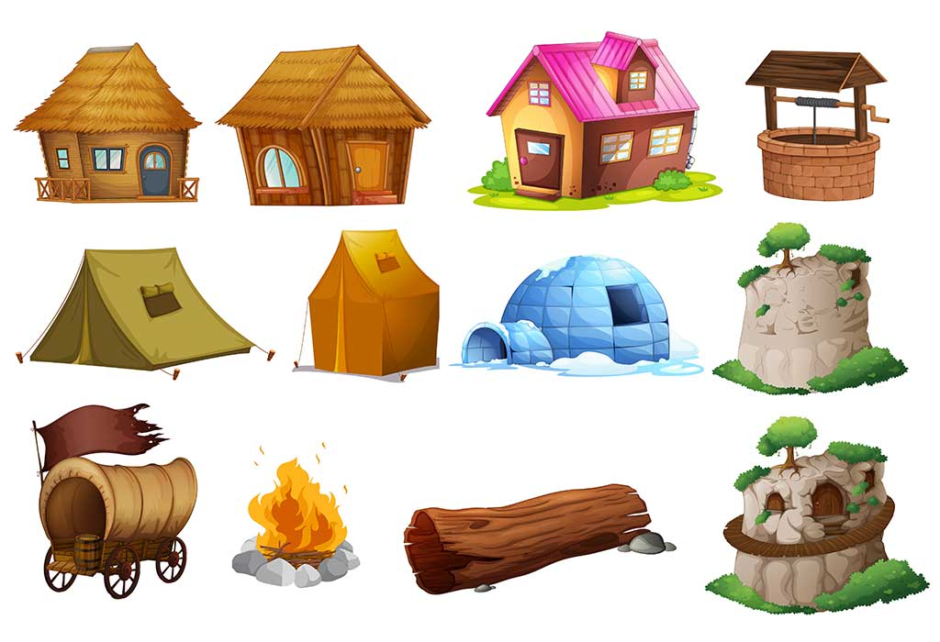

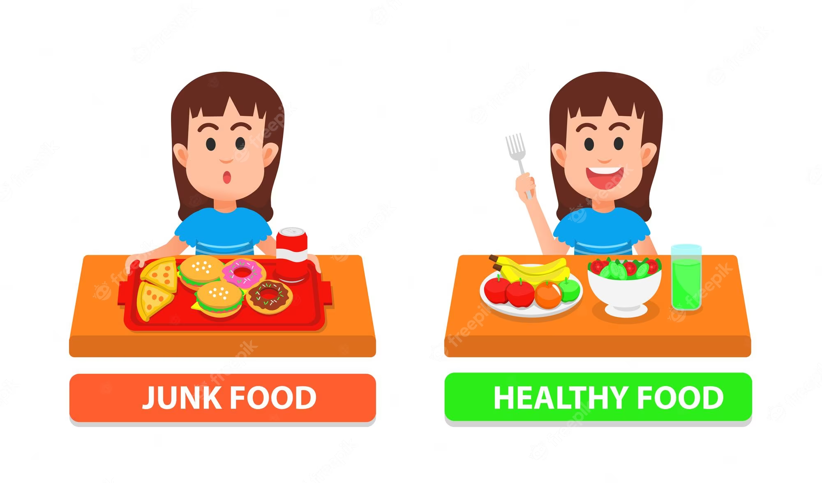
Understanding the World Around US (EVS)

Slide 13
PP2 OVERVIEW OF CONCEPTS
ENGLISH
MATH
Alphabet Song- Orals
Vowels and Consonants
Cursive writing
Sentence Writing
Position, Action words
Numbers 51 to 100 :Orals
Number names 1 to 100
Backward counting
Shapes- Square, Rectangle, Triangle and Circle.
Tall/ Short, Big/ Small
Missing , before, after, in between numbers
Addition and Subtraction

Slide 14
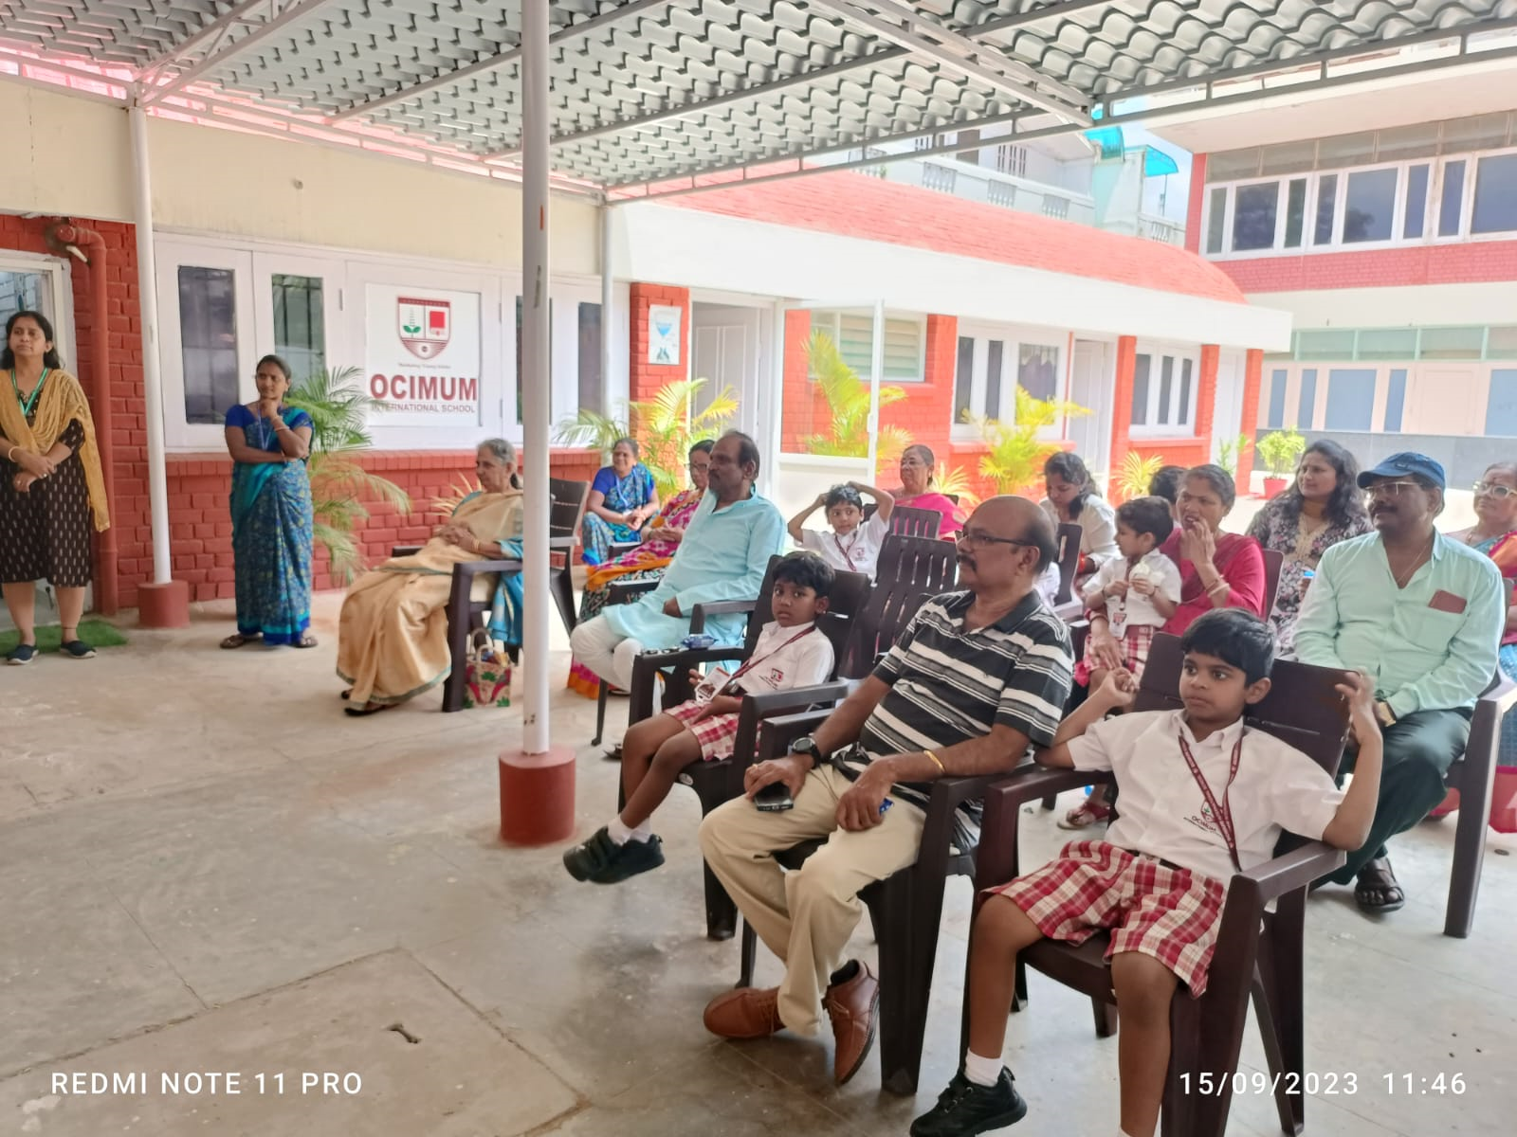
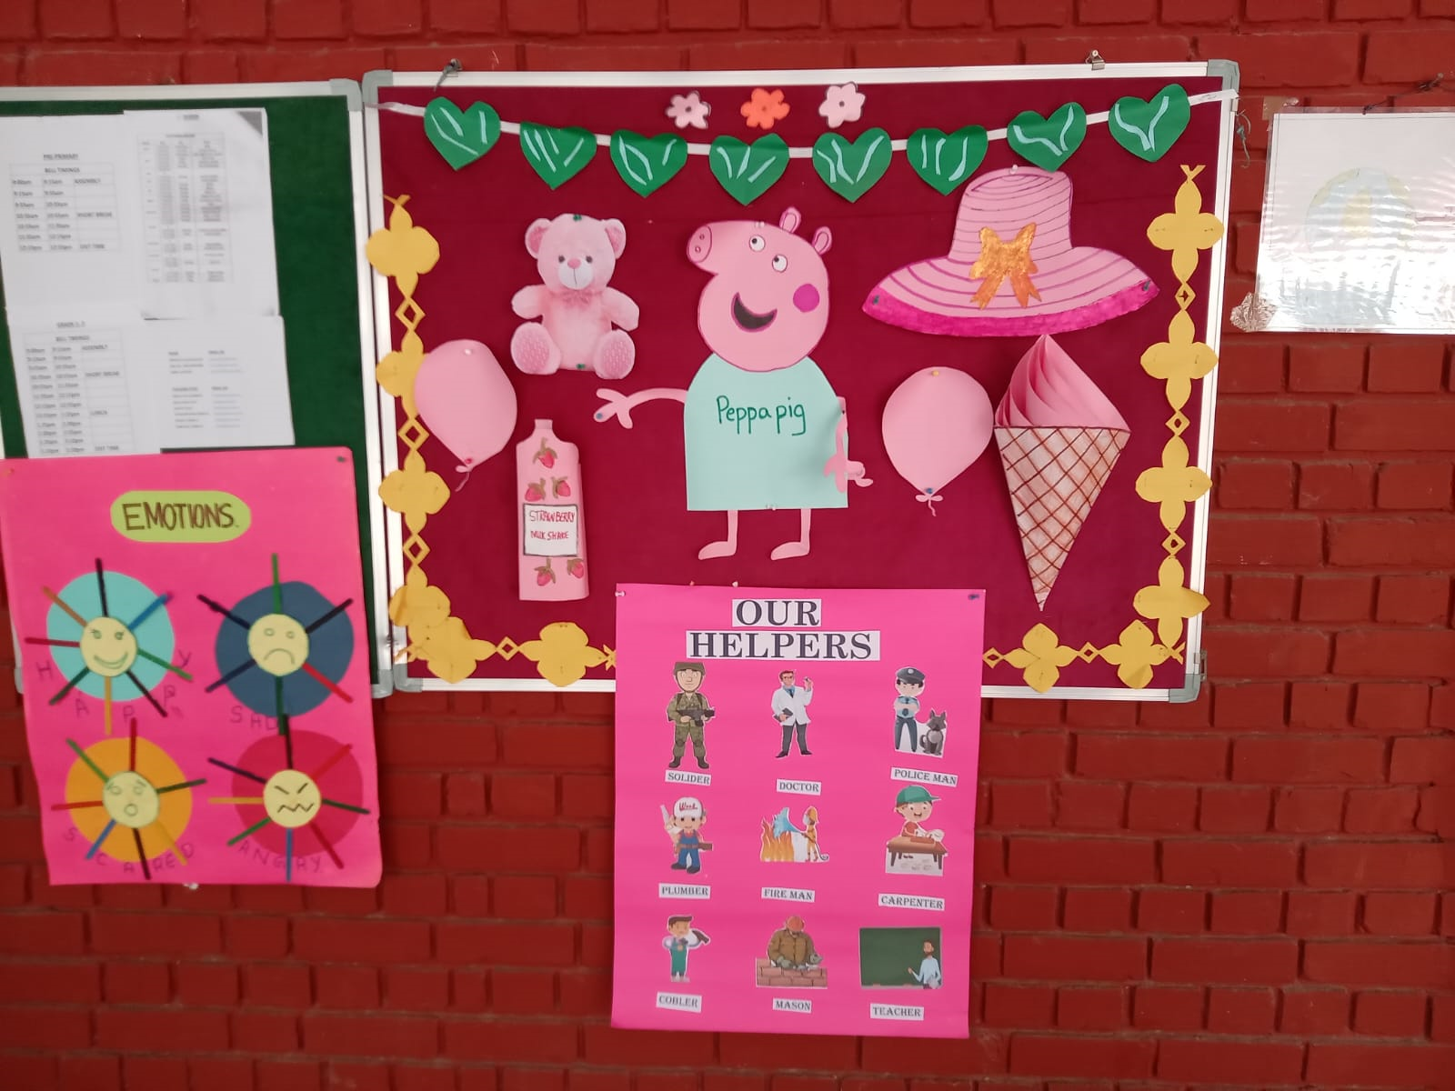
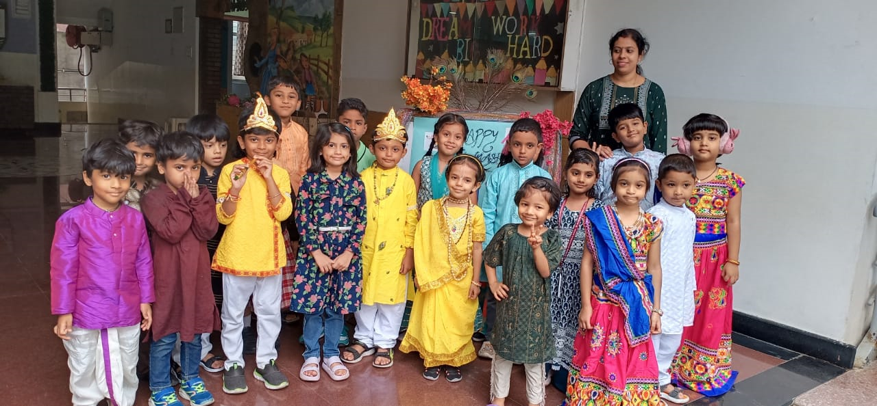
SPECIAL DAYS AND ACTIVITIES
Celebrations are always fun. We at Ocimum International School encourage each and every little one to participate in different by organizing various fun activities to teach our children life and learning, happiness and pride are great feelings to acknowledge, feel and celebrate.
Earth Day
Mother’s Day
Father’s Day
World Environment Day
International yoga Day
Children’s Day
Colour Day
Kids Kitchen
Thanksgiving Day
Grandparents Day
Yoga Day

Slide 15
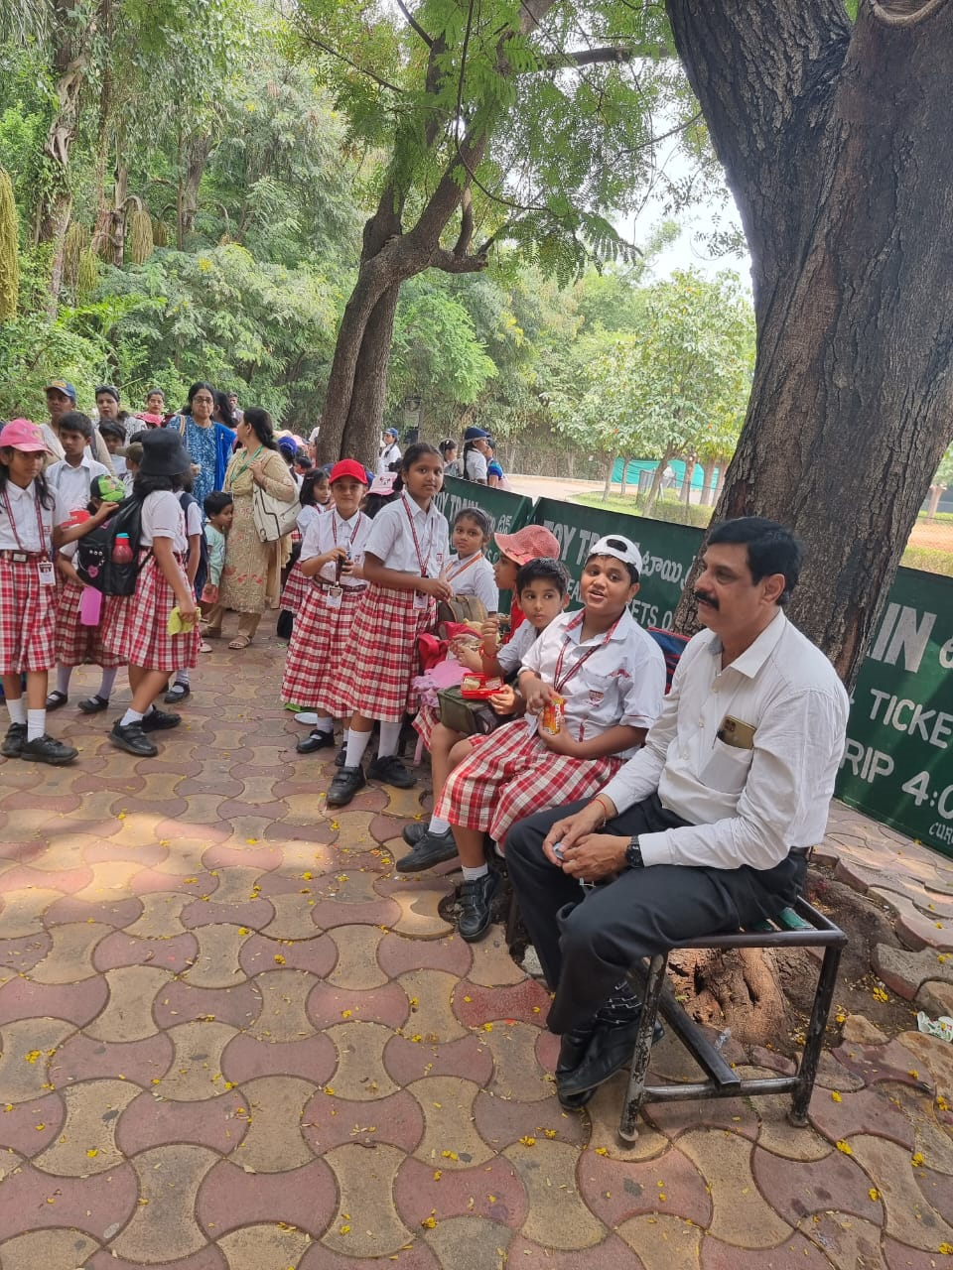
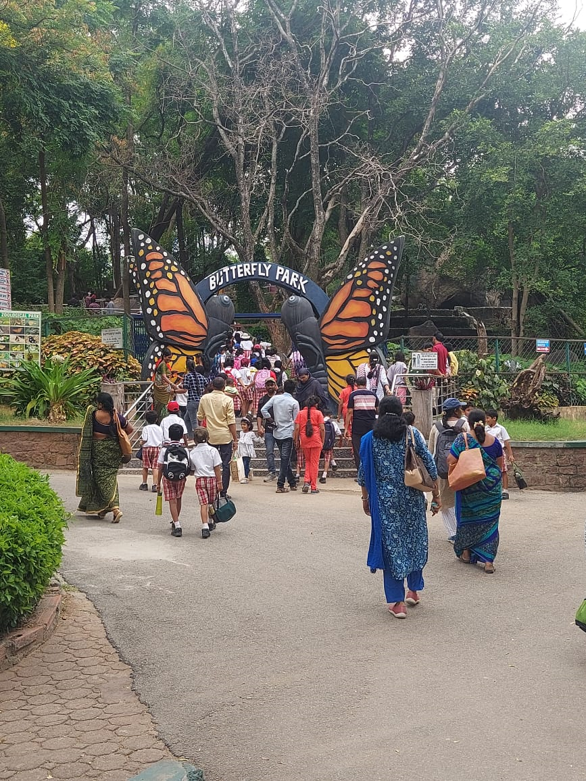
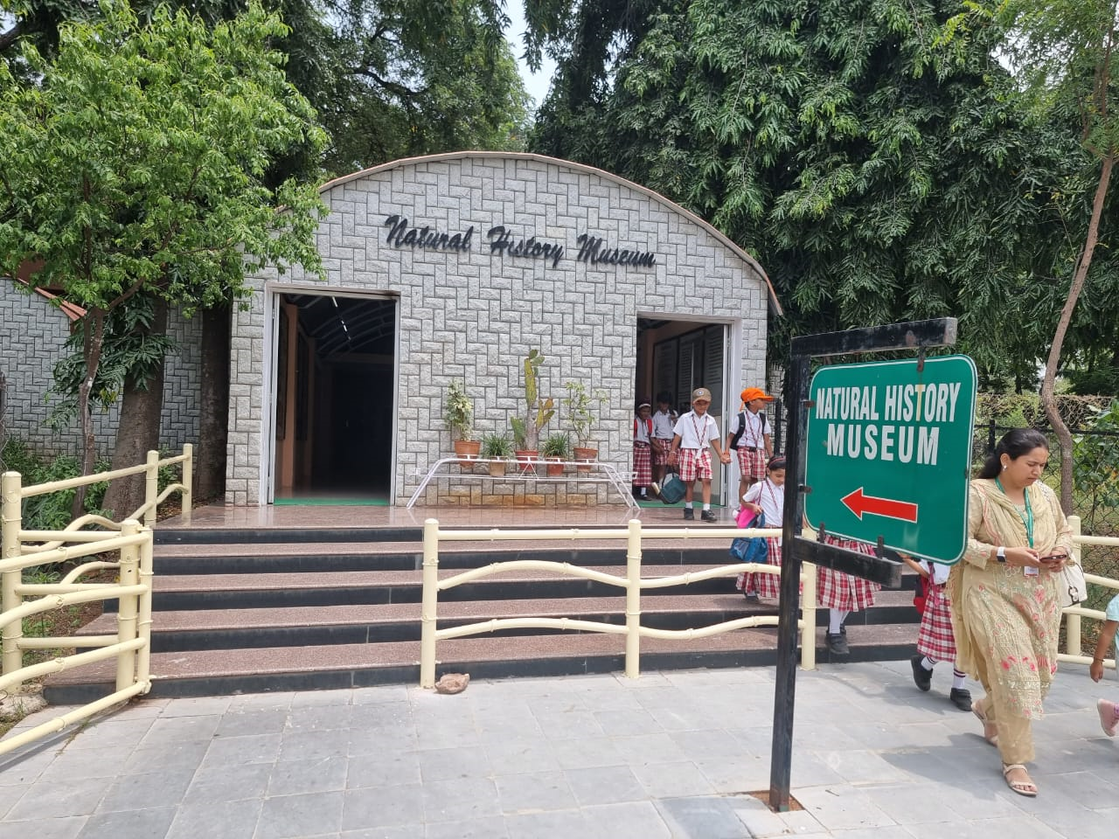
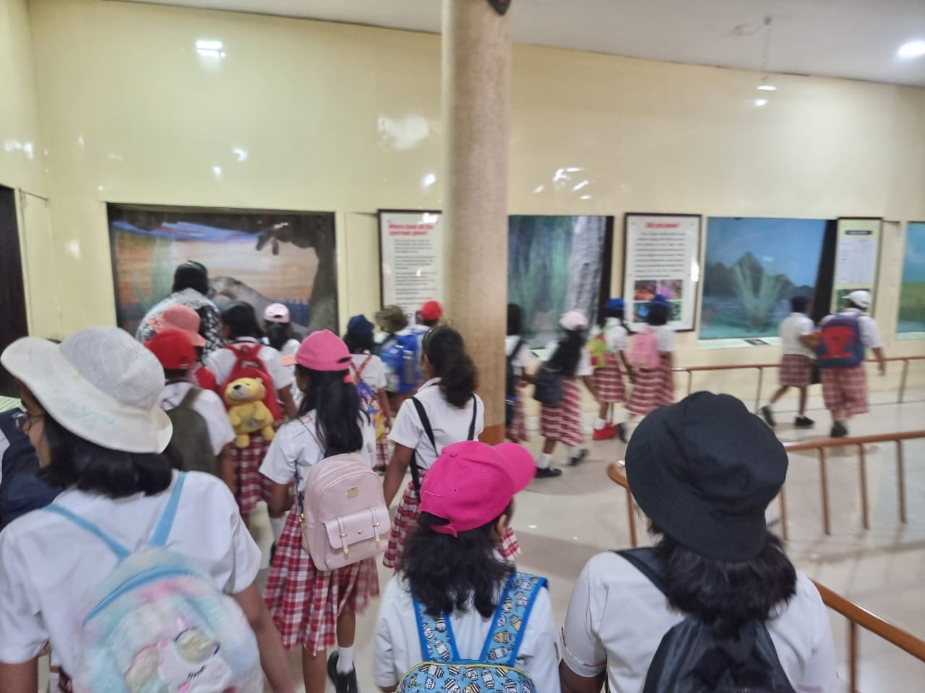
EDUCATIONAL FIELD TRIPS

Slide 16
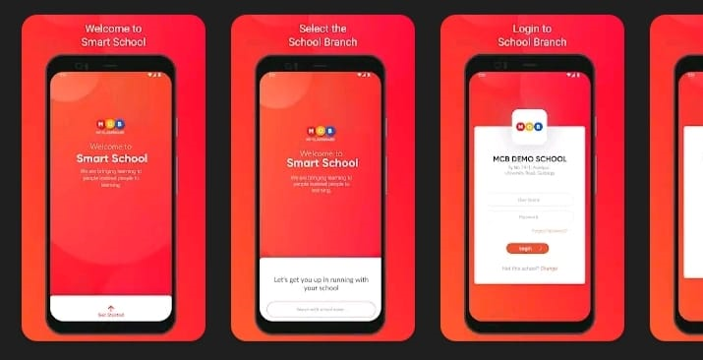
MY CLASS BOARD
My Class board , an India’s pioneer in the field of School is a School Software platform with a suite of modules to automate school management process.. My Class board learning Management System provides every tool to make classes engaging, informative and productive.

Slide 17




FOLLOW US
School website
https://ocimum.edu.in/
School Facebook page
Ocimum School
School Instagram page
Ocimum Parents
School Youtube channel
ocimuminternational@gmail.com

Slide 18


